Slide 1


Graphology & Mind Set Intensive Program
BY- Veena Puppala

Slide 2


Graphology & Mind Set Intensive Program
Do You Know Graphology

Slide 3

Graphology & Mind Set Intensive Program
Do You Want to Improve Confidence

Slide 4
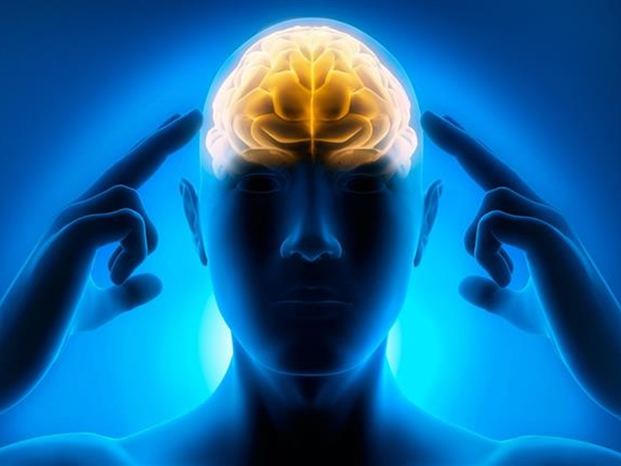
Graphology & Mind Set Intensive Program
Do You want to Control Your mind??

Slide 5
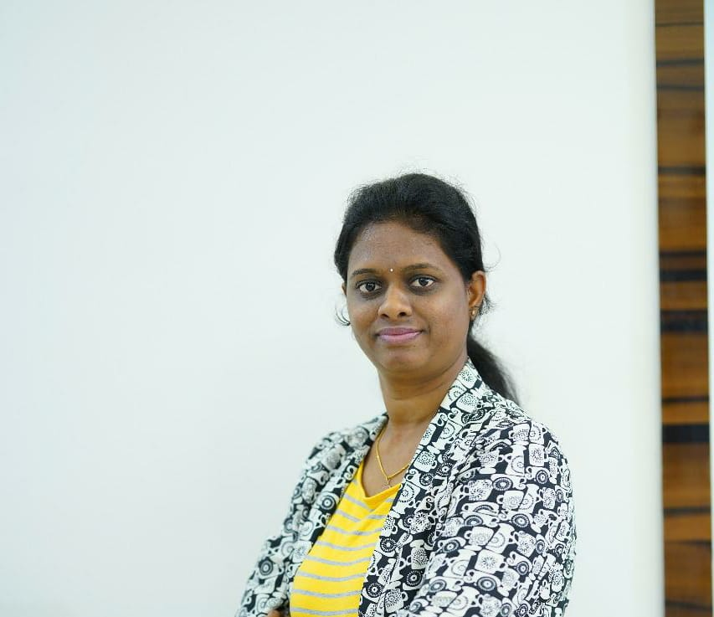
About Me
I am Veena Puppala
Graphologist & Mind Coach
CEO Of Multe Arts
Mother
I Quit My Job To Train
Young Minds of the Country
To get Skill Development
Using Graphology

Slide 6

What is MulteArts

Slide 7
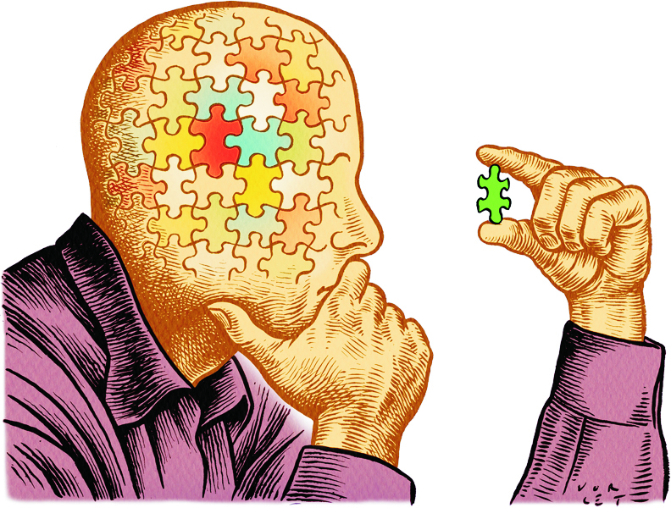
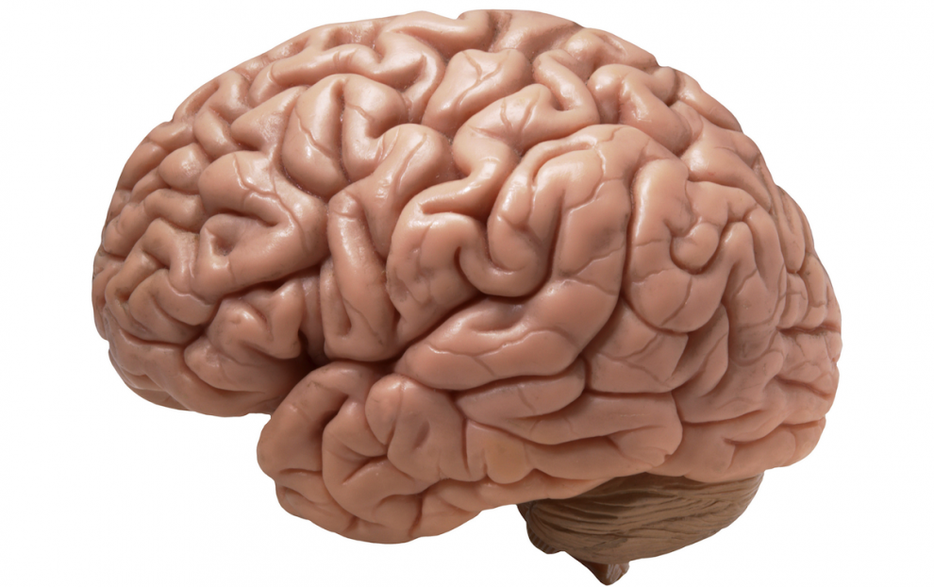
Before Going to Know More About Graphology
Concept of Mind

Slide 8
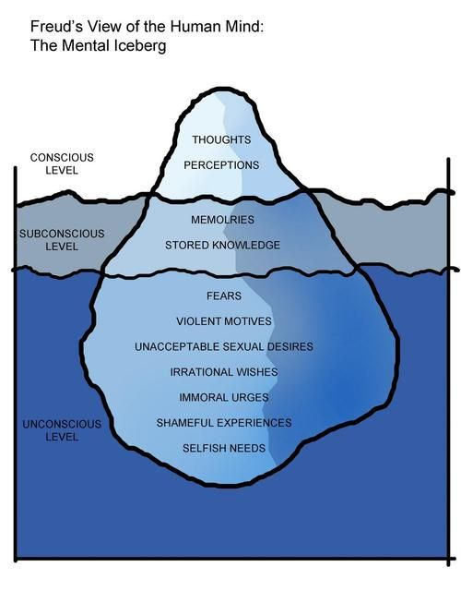
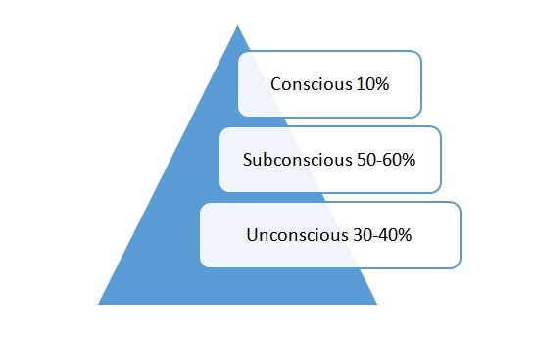
Understanding sub conscious pattern

Slide 9
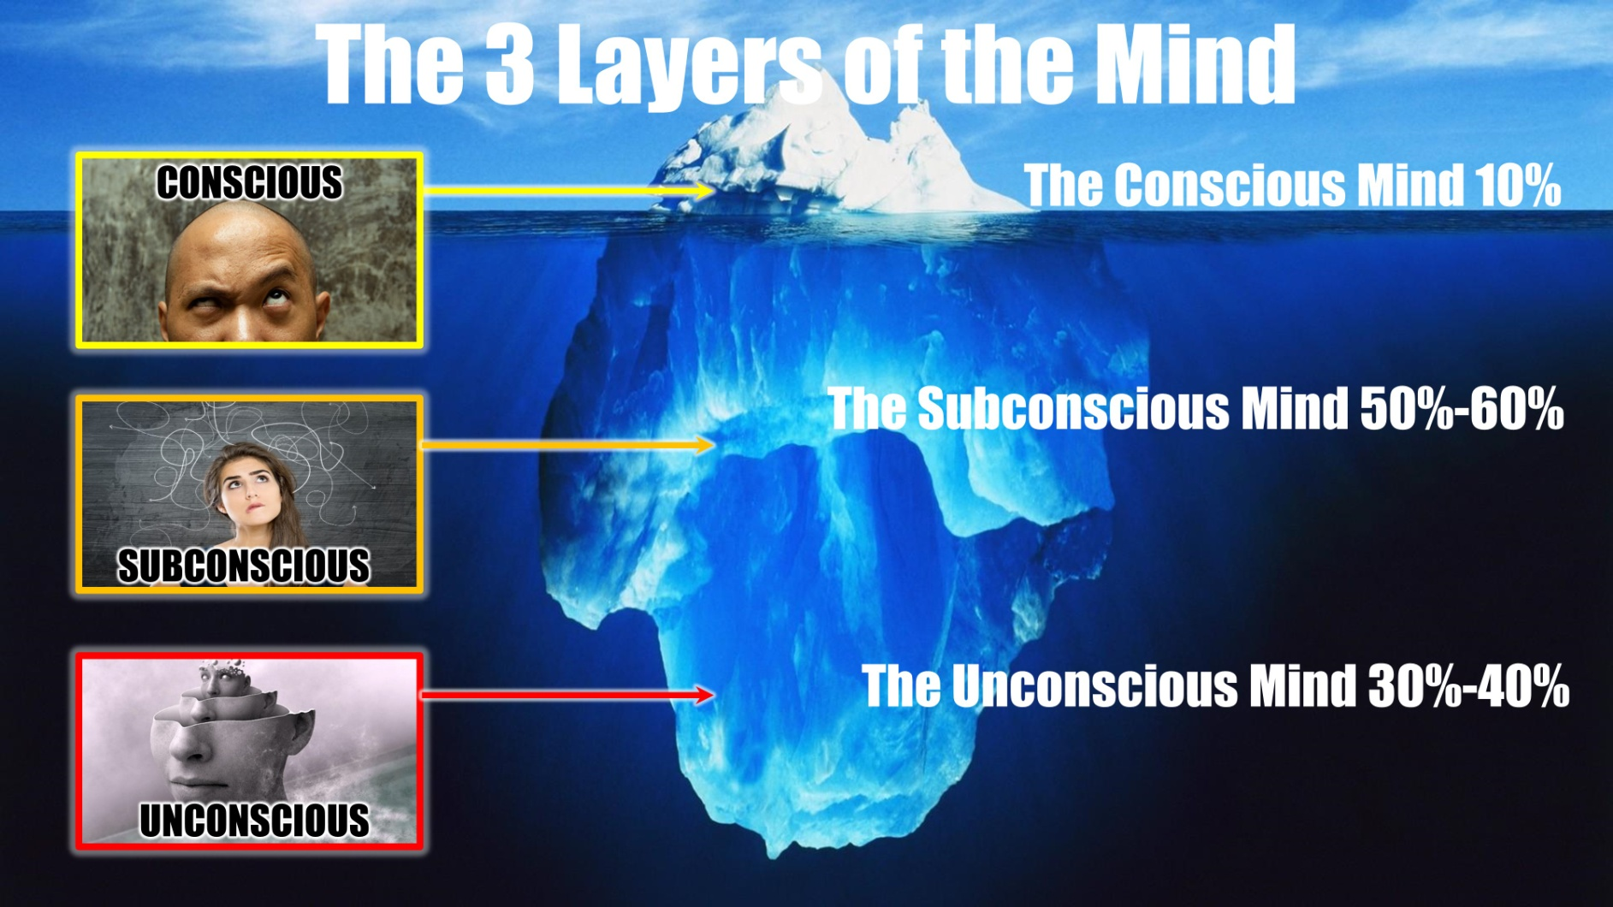

Slide 10
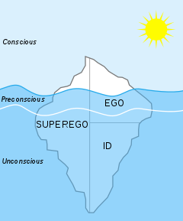

Slide 11
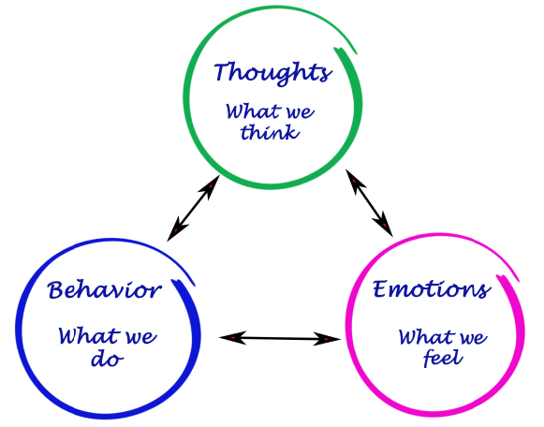
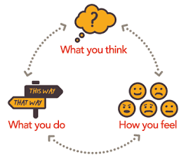
Understanding sub conscious pattern
Analysis your Behavior

Slide 12

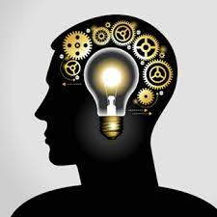
Fix it
Re work

Slide 13

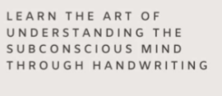
Graphology Help us to Rework
Re work

Slide 14


Benefits of Graphology
Graphology Increase Resume weight

Slide 15


Benefits of Graphology
Graphology Increase Confidence

Slide 16


Benefits of Graphology
You Can Create impression in Interview process

Slide 17
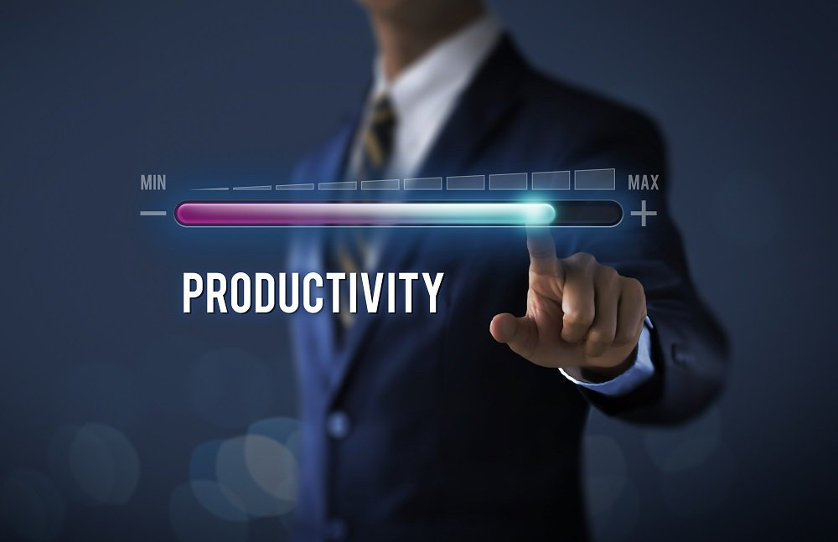
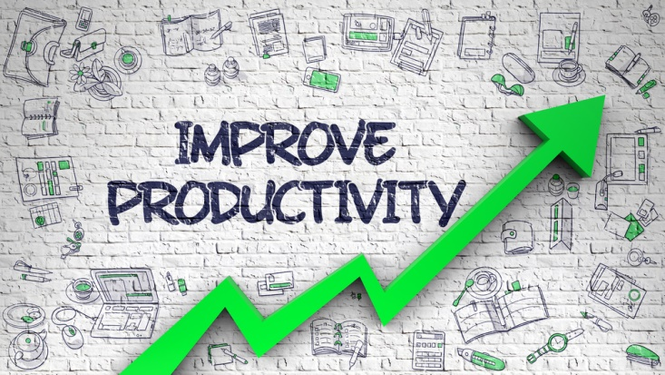
Benefits of Graphology
You Can Increase Your Productivity

Slide 18


Benefits of Graphology
You Can Be Very Unique

Slide 19

What is the Use of Graphology
Understanding your Skills.
Graphology in Parenting.
Knowing your family , friends and relatives.
Selecting Life partner.
Selecting Business partner
Child development and Hidden skills in Children .
Recruitment in Jobs.

Slide 20
How to generate Money from Graphology
Handwriting Analysis report for individuals
Compatibility report for marriage proposals
Using in recruitment process
Forensic report
Guest lectures in schools and colleges.
Grapho Therapy for child and individuals

Slide 21
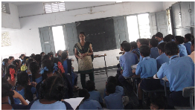
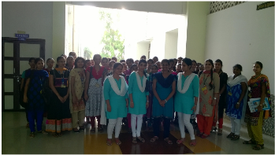
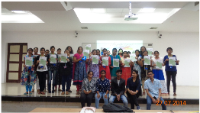
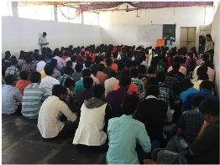

Slide 22


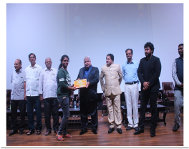

Slide 23
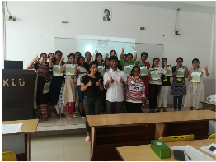
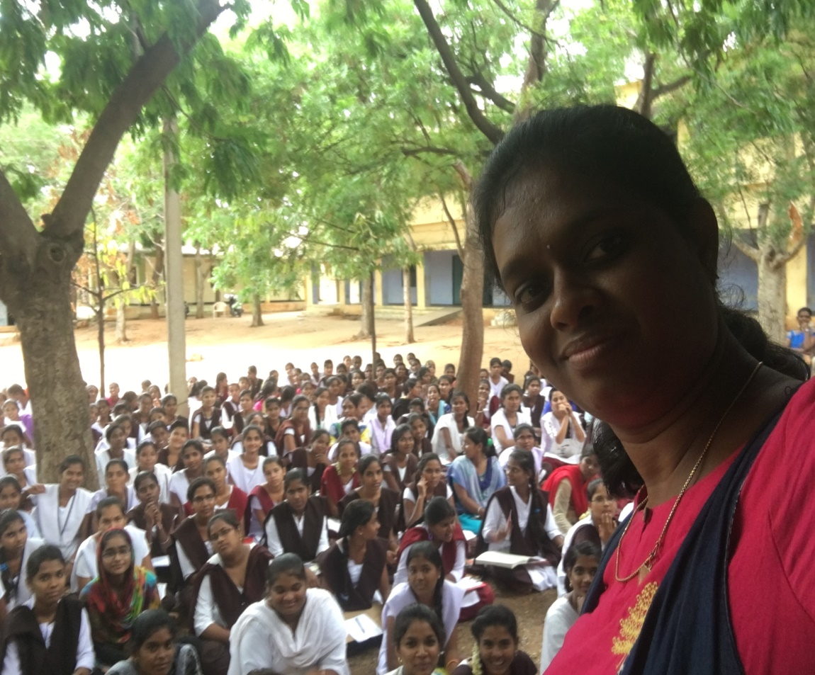

Slide 24
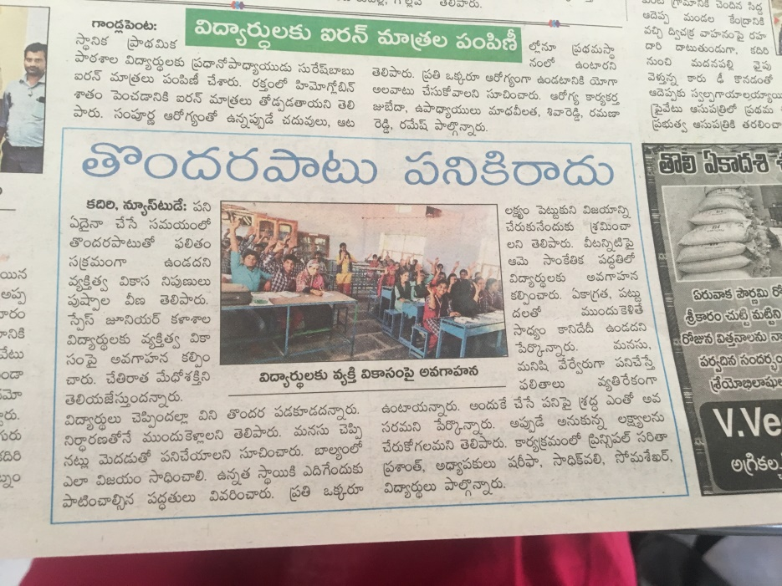
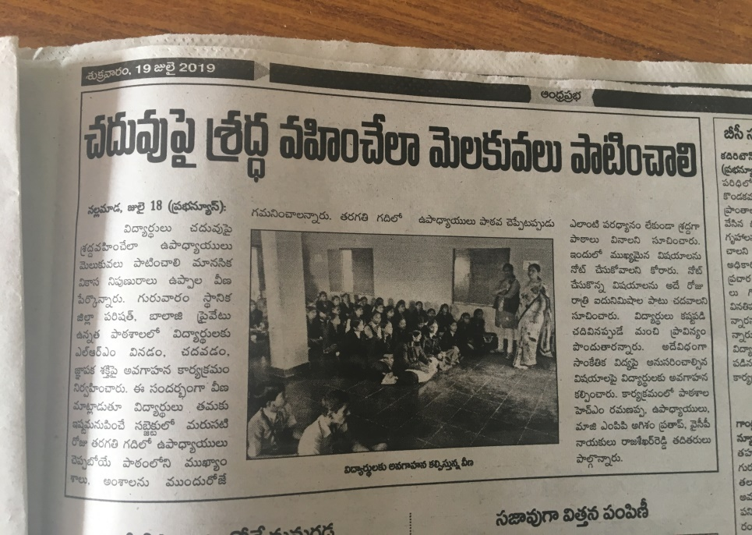
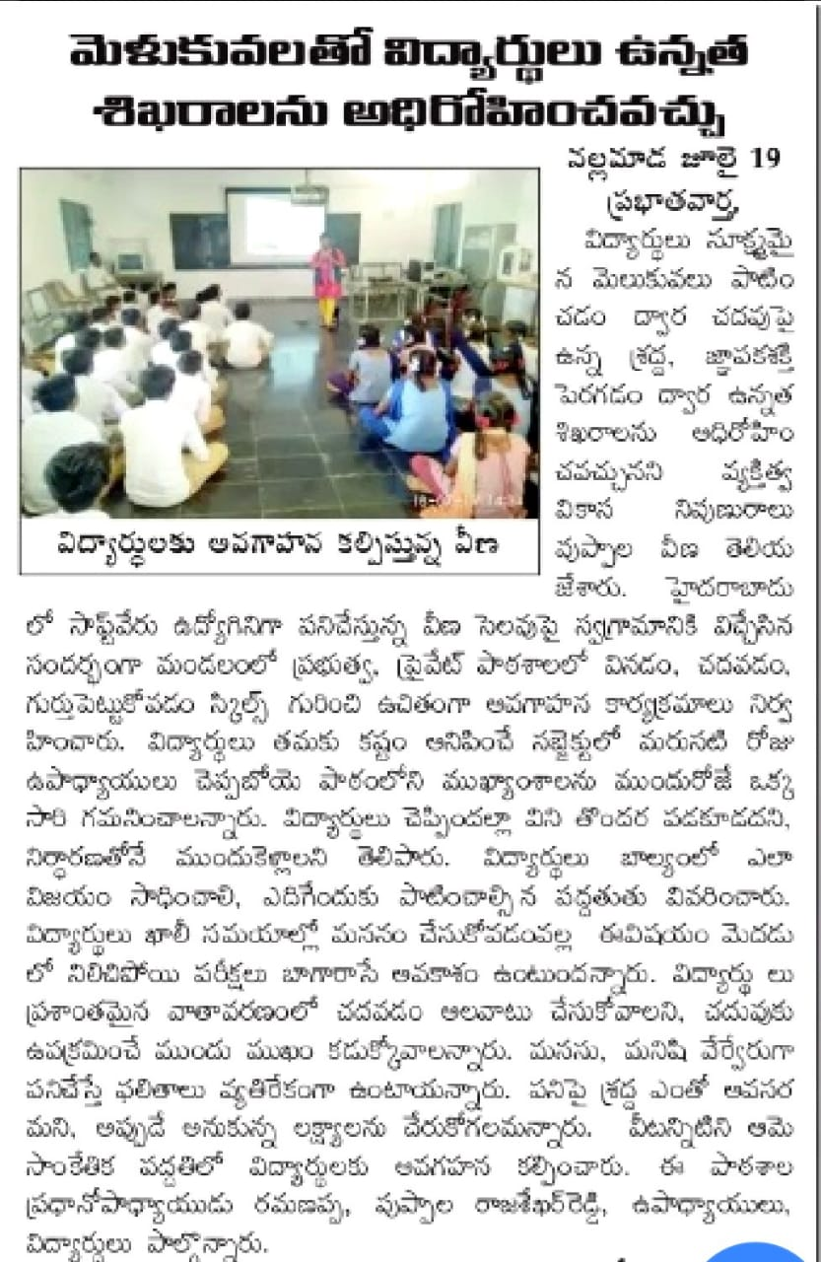
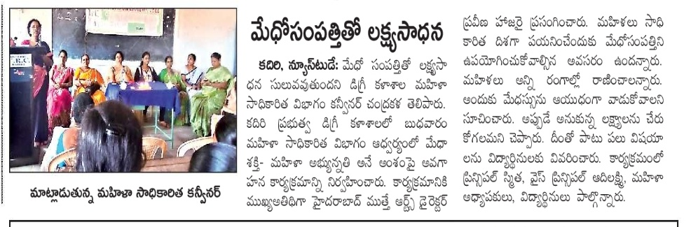

Slide 25
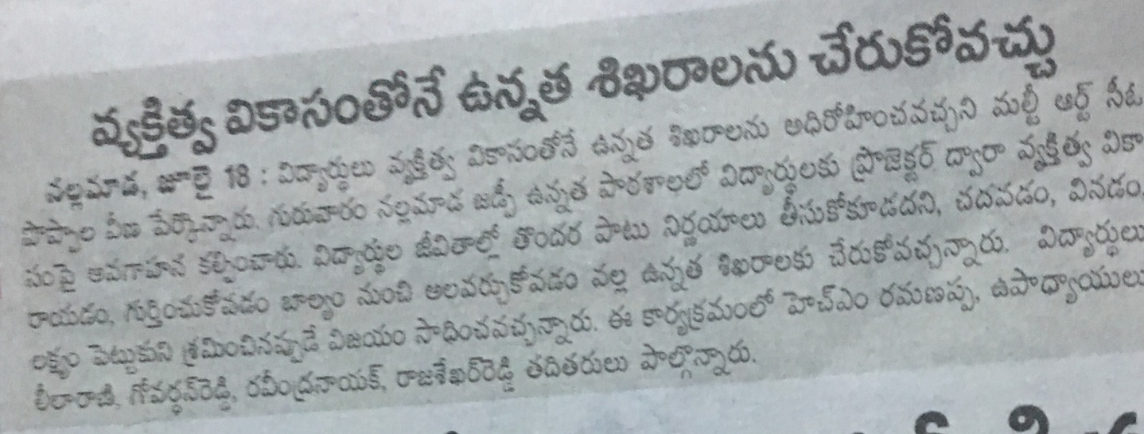
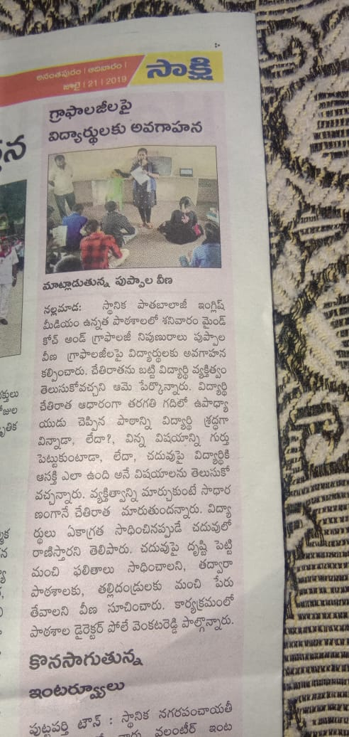
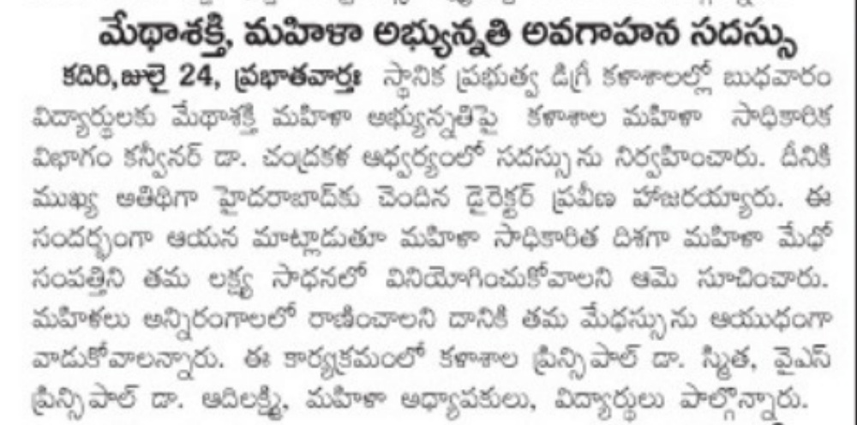

Slide 26

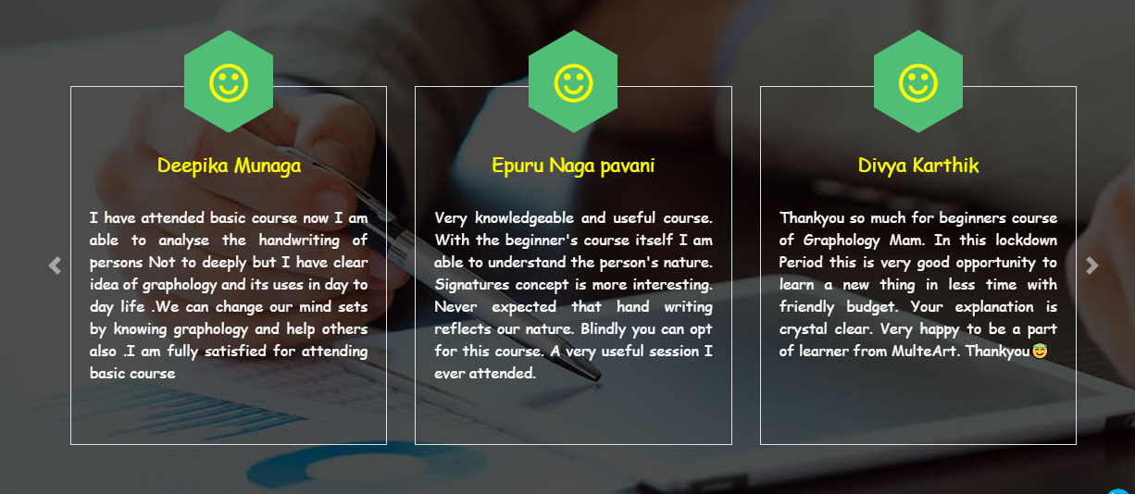
Feedback

Slide 27
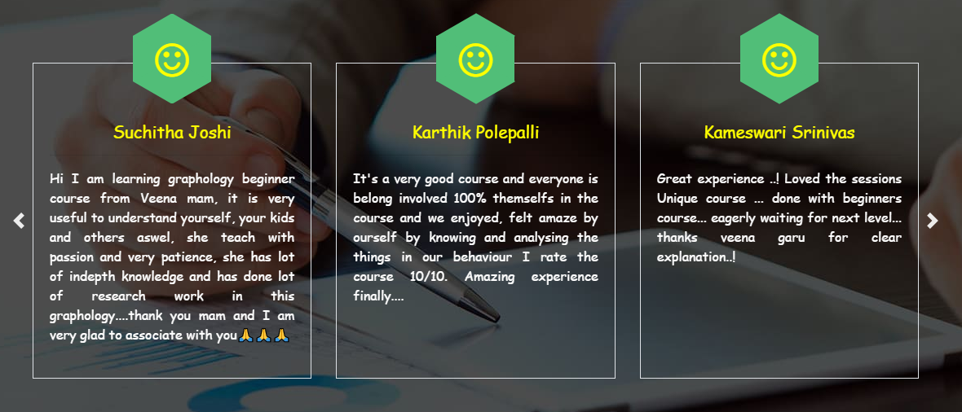

Slide 28
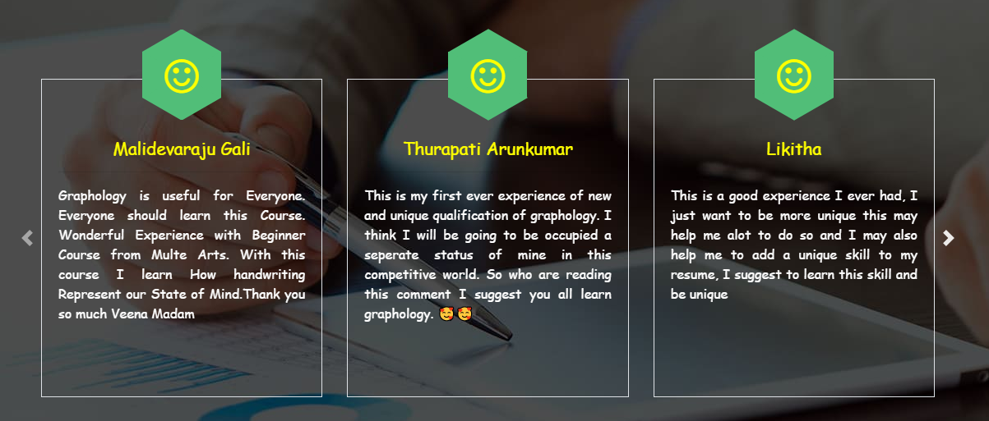

Slide 29
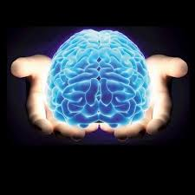
Graphology is Magic…….

Slide 30


Slide 31
Fee Structure
Graphology course for beginners
Get a certification from Multe Arts PVT LTD.
Which will be a added factor in your resume and give wait to your resume.
You can project yourself as a unique person
Only 2300 rupees
Get Now @999

Slide 32


3 days Course

Slide 33
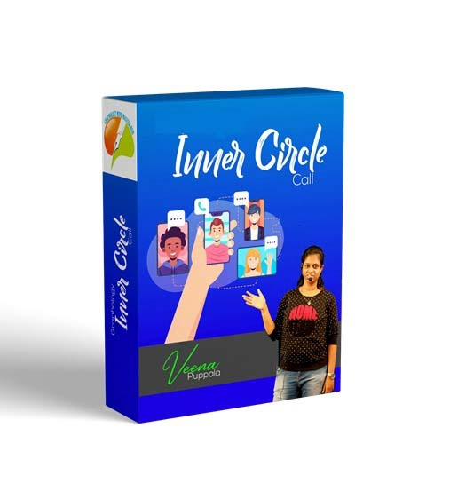
Bonus Gift for Quick Decision Makers
Worth 25000 Course
You will receive Live session For Free..

Slide 34
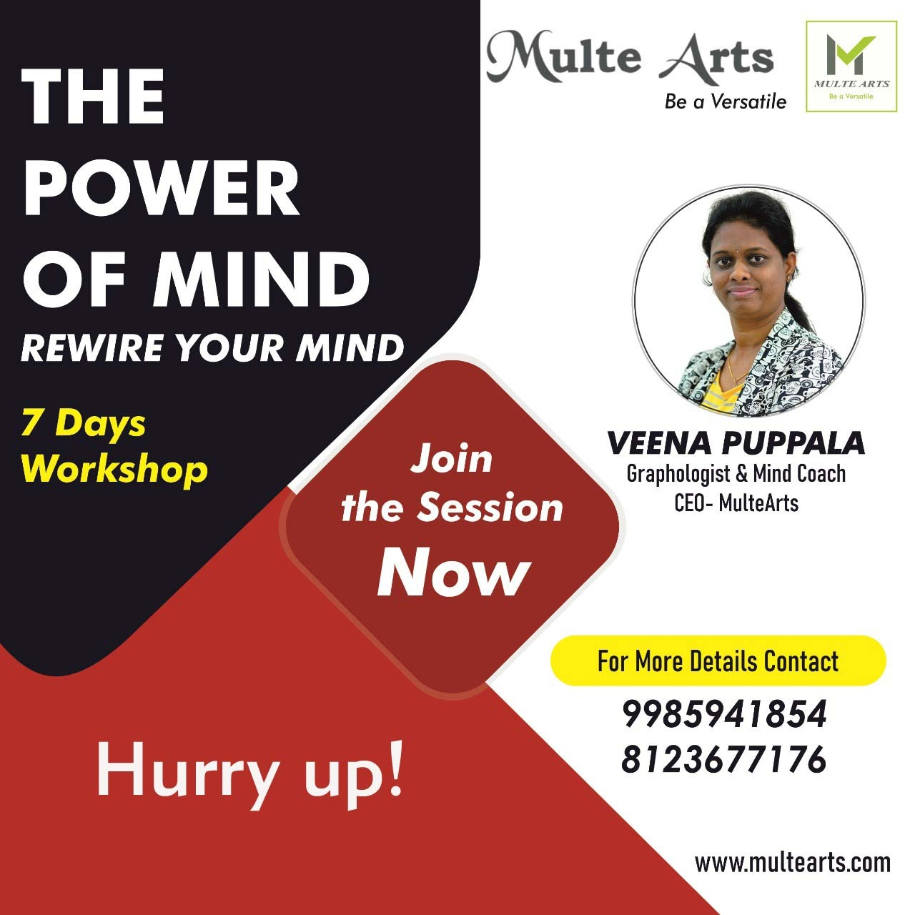
Bonus Gift for Quick Decision Makers
Worth 1000 Course
You will receive Live session Archives For Free..

Slide 35
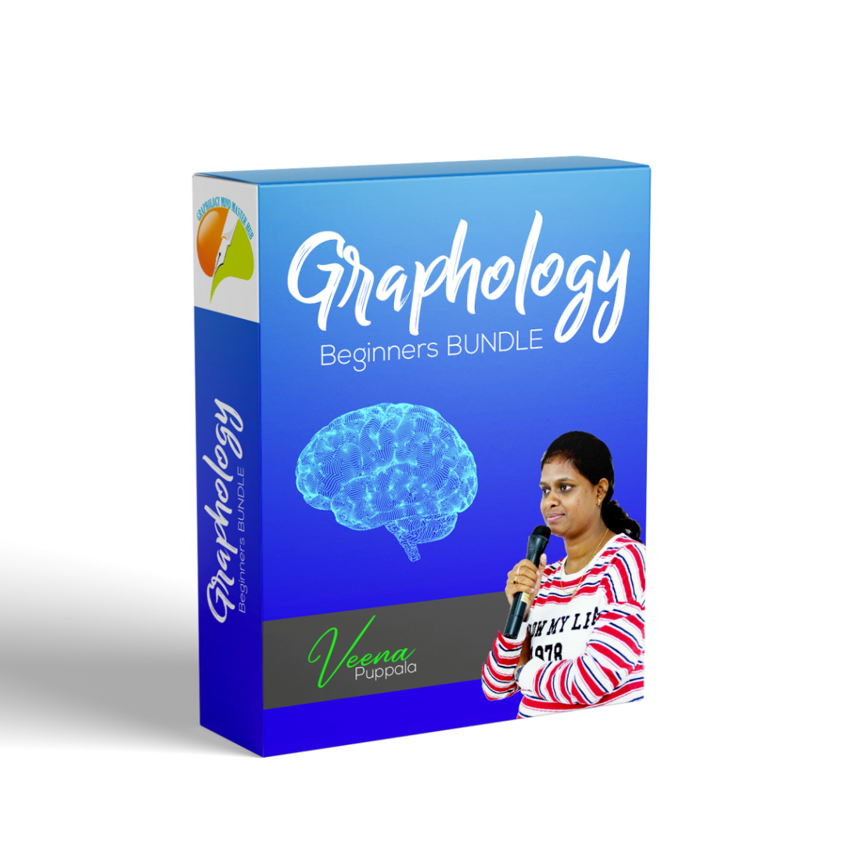

You Will Have
Value : 28300

Slide 36
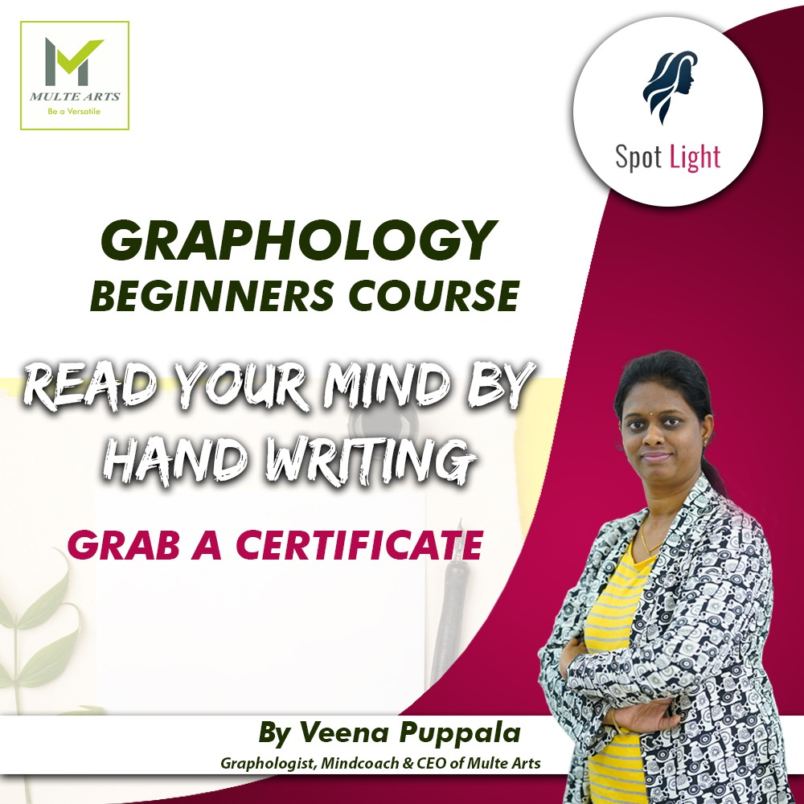
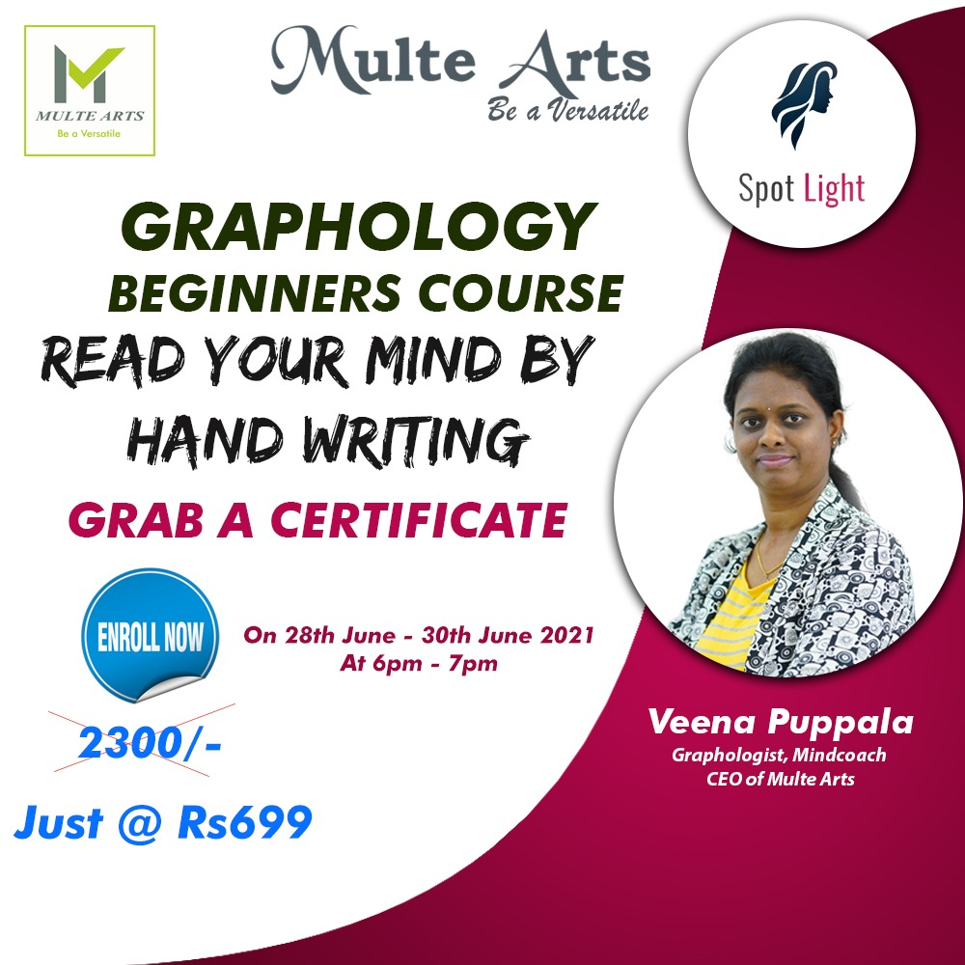
Value 699

Slide 37
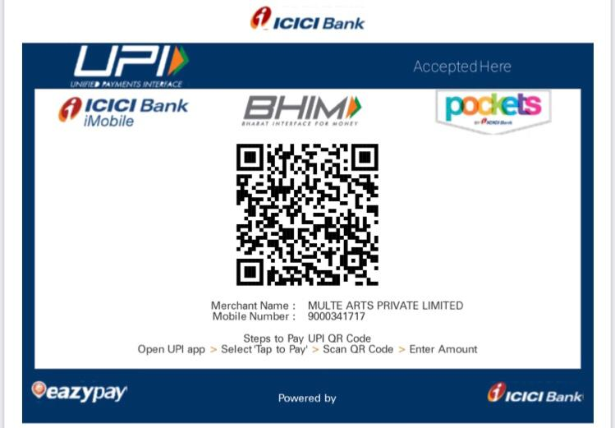
Value 699

Slide 38
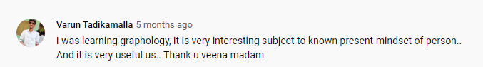
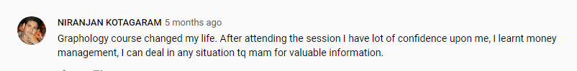
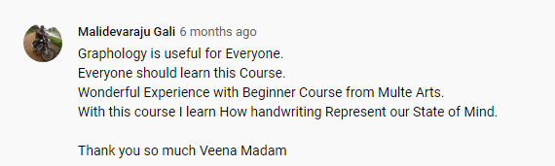

Slide 39
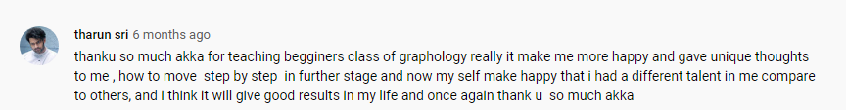
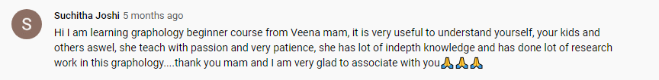
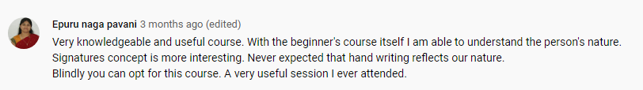

Slide 40
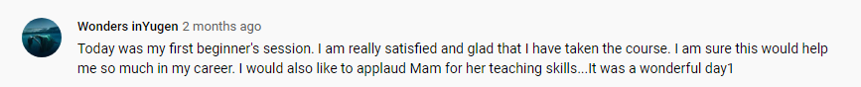
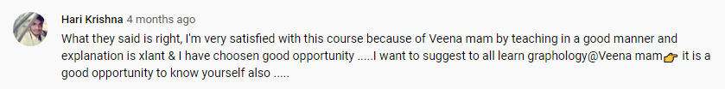
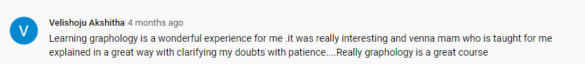
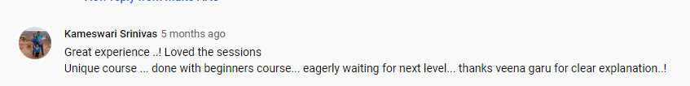

Slide 41



Self Test Using Graphology
Dot on I
High T Bars
Signature Straight

Slide 42


